Slide 1
SpringBoot Controller测试

Slide 2
单元测试
&
集成测试

Slide 3
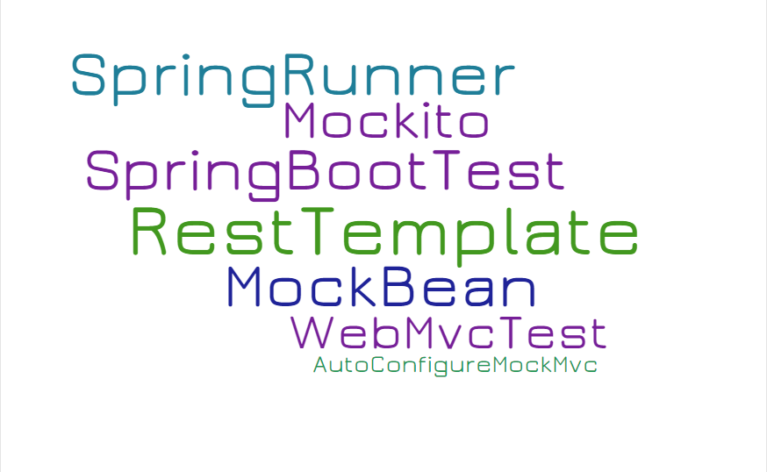

Slide 4
MockMVC - Standalone
Application Context
WebServer
HTTP Filter
Controller Advice
Test scope
WorkerService
Controller under Test
IWorkerService
TestRestTemplate
HTTP Filter
Test
Other SpringBoot Beans
Controller Advice
Other SpringBoot Beans
Application
logic
Spring
Bean
Mocked
Object
Created by Test

Slide 5
MockMVC - With Context
Application Context
WebServer
HTTP Filter
Controller Advice
IWorkerService
Controller under Test
TestRestTemplate
Test
Other SpringBoot Beans
Other SpringBoot Beans
Application
logic
Spring
Bean
Mocked
Object
Created by Test

Slide 6
SpringBootTest & MockMVC
Application Context
WebServer
HTTP Filter
Controller Advice
IWorkerService
Controller under Test
TestRestTemplate
Test
Other SpringBoot Beans
Other SpringBoot Beans
Application
logic
Spring
Bean
Mocked
Object
Created by Test

Slide 7
SpringBootTest
Application Context
HTTP Filter
WebServer
Controller Advice
IWorkerService
Controller under Test
TestRestTemplate
Test
Other SpringBoot Beans
Other SpringBoot Beans
Application
logic
Spring
Bean
Mocked
Object
Created by Test

Slide 8
Thanks

